Slide 1

Computer Programming With C++!
While you’re waiting, check out the “Programmer Scavenger Hunt” handout!!

Slide 2
Computer Programming With C++!

Slide 3
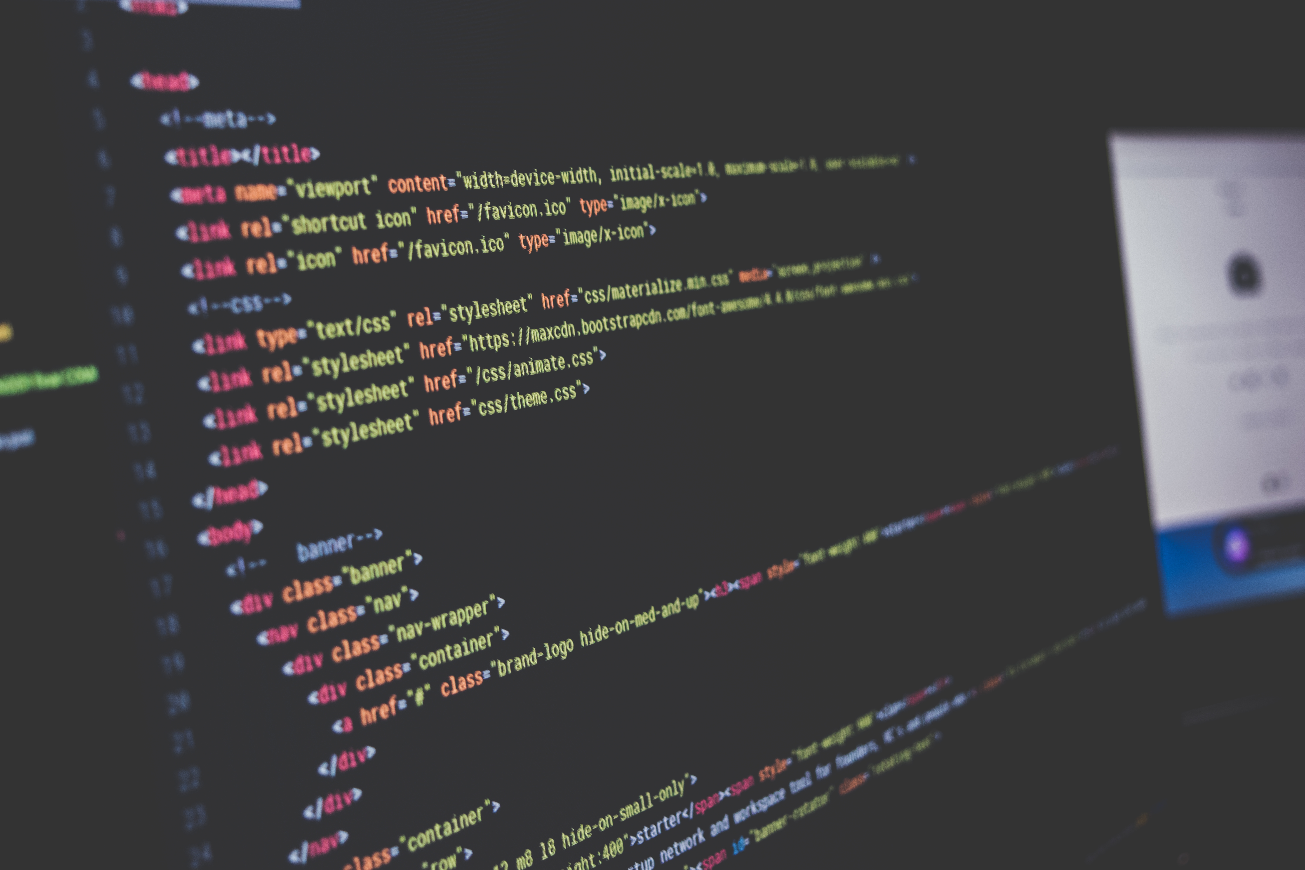
Learning Objectives
Basic programming concepts!
Logic statements!
Input/output!
Math calculations!
Program commenting!
unsplash.com
Notes:
Understand and utilize basic programming concepts such as data types (int, string, char, double)
if-statements, switch-statements, and loops
Input/output text through the console
Write programs to perform simple calculations
Explain the importance of comments in code

Slide 4
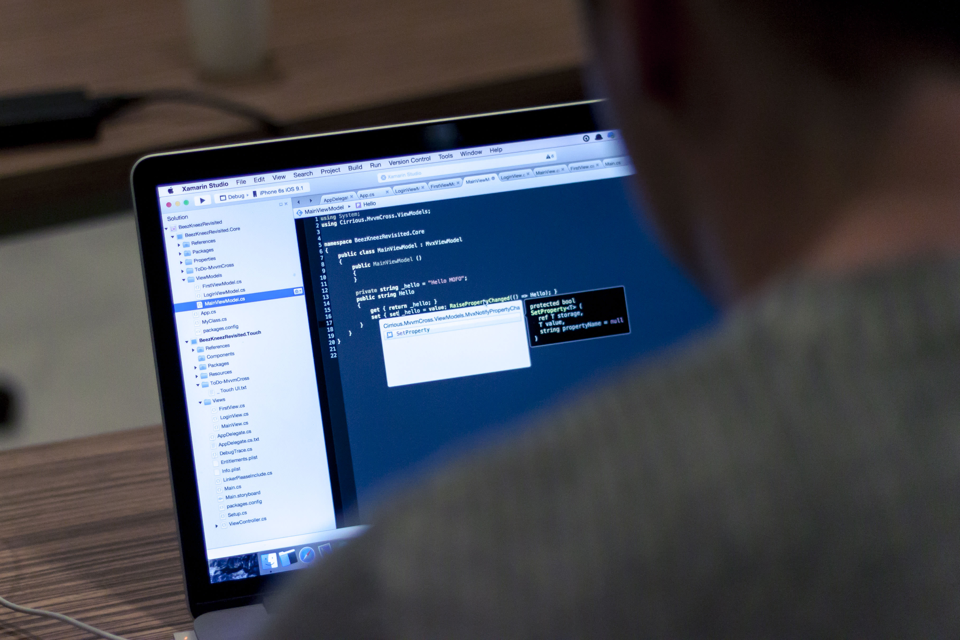
Welcome!
Ask questions
Brainstorm
Work together
Have fun!
unsplash.com
Notes:
Here are some things I want YOU to do during this workshop:
I want you to ask questions throughout this workshop.
“Why is a cout statement called a cout statement?”
“What if I want to loop something within a loop?”
“Why should we initialize a variable?”
There is NO SUCH THING as a stupid question.
Throughout this workshop I want you to be thinking of what you want your final project to be. As the final project, you will write (or at least begin) your own program.
I also want you to work with and talk with your classmates.

Slide 5
Programing is about…
Instructions for the computer
Build applications/software
Learn as you go
Notes:
Programming is about writing instructions for the compuer!
Computers will do whatever you tell them to do. Unfortunately, they cannot understand plain English. So we program apps and other software in a LANGUAGE that it can understand. Our programming language is called “C++”.
The way I and many other people use programming is to make applications or software. Mobile games, word processors, utility apps, video games, movie editors, and so much more!
Angry Birds
Infinity Blade
Facebook
Instagram
The average iPhone app is made up of less than 500 lines of code. (http://www.informationisbeautiful.net/visualizations/million-lines-of-code/)
Programming is about learning as you go. You don’t need to know everything about it to start programming. Programming involves an incredible amount of seeking help from others using
forums,
google,
example programs,
tutorials,
blogs,
conversations,
etc..
I’ve almost never written a program without looking something up. Often, I look TONS of things up. It’s part of programming.

Slide 6

robrayburn.deviantart.com
Notes:
Angry Birds

Slide 7

epicgames.com
Notes:
Infinity Blade

Slide 8

commons.wikimedia.org
Notes:
Facebook

Slide 9

techinsider.io
Notes:
Instagram
These are all made by programmers!

Slide 10
Programing
Instructions for the computer
Build applications/software
Learn as you go
Notes:
Computers will do whatever you tell them to do. Unfortunately, they cannot understand plain english. Programming is about giving the computer instructions in a LANGUAGE that it can understand. Our programming language is called “C++”.
The way I and many other people use programming is to make applications or software. Mobile games, word processors, utility apps, video games, movie editors, and so much more!
Angry Birds
Infinity Blade
Facebook
Instagram
The average iPhone app is made up of less than 500 lines of code. (http://www.informationisbeautiful.net/visualizations/million-lines-of-code/)
Programming is about learning as you go. You don’t need to know everything about it to start programming. Programming involves an incredible amount of seeking help from others using
forums,
google,
example programs,
tutorials,
blogs,
conversations,
etc..
I’ve almost never written a program without looking something up. Often, I look TONS of things up. It’s part of programming.

Slide 11

Part 1
Comments
Console output
Variables
User input
Simple math
unsplash.com

Slide 12
Comments
//This is a comment! Any text written after the two forward slashes (//)
//will be ignored by the compiler.
//Comments are used to describe what the program does to people reading the code.
//Try writing a comment at the top of your code that contains
//your name, today's date, and the name of this program ("Hello World").
Notes:
//This is a comment! Any text written after the two forward slashes (//)
//will be ignored by the compiler.
//Comments are used to describe what the program does to people reading the code.
//Try writing a comment at the top of your code that contains
//your name, today's date, and the name of this program ("Hello World").
#include <iostream> //This is a library.
//We are "importing" a bunch of code that other people
//have written, so that we don't have to write it.
using namespace std; //The specifics of this are a little beyond the scope of this workshop.
//Suffice it to say, this makes writing the programs a little easier.
//The semicolon (;) indicates the end of a line.
//The code will produce an error without it.
int main() //This is called the "main function."
//Functions will be described more later in this workshop.
//"int" stands for "integer". An integer is a whole number,
//like 1, 2, 5, or 235. The "int" means that the "main function"
//"returns" an integer when the program is done.
//This will be further explained later.
{ //This is called a curly bracket. This represents the start of the "main function".
cout << "Hello World" << endl; //This line of code actually does something!
//It prints the words "Hello World" to the console window.
//What does that mean? Why don't you run the code and find out!
//Ask your instructor how to run your code)
//As you can see, a little window (called the console window)
//opens up and displays the words "Hello World".
return 0; //This is that "return" thing I mentioned above.
//This "main function" returns an integer value (0) to let the
//programmer know that the program executed successfully.
} //This curly bracket represents the end of the "main function".
//Congratulations! You just wrote your very first program!
//You're well on your way to becoming a programmer!

Slide 13
Exercise 1.1: Hello World
#include <iostream>
using namespace std;
int main() {
cout << "Hello World" << endl;
return 0;
}
Notes:
//This is a comment! Any text written after the two forward slashes (//)
//will be ignored by the compiler.
//Comments are used to describe what the program does to people reading the code.
//Try writing a comment at the top of your code that contains
//your name, today's date, and the name of this program ("Hello World").
#include <iostream> //This is a library.
//We are "importing" a bunch of code that other people
//have written, so that we don't have to write it.
using namespace std; //The specifics of this are a little beyond the scope of this workshop.
//Suffice it to say, this makes writing the programs a little easier.
//The semicolon (;) indicates the end of a line.
//The code will produce an error without it.
int main() //This is called the "main function."
//Functions will be described more later in this workshop.
//"int" stands for "integer". An integer is a whole number,
//like 1, 2, 5, or 235. The "int" means that the "main function"
//"returns" an integer when the program is done.
//This will be further explained later.
{ //This is called a curly bracket. This represents the start of the "main function".
cout << "Hello World" << endl; //This line of code actually does something!
//It prints the words "Hello World" to the console window.
//What does that mean? Why don't you run the code and find out!
//Ask your instructor how to run your code)
//As you can see, a little window (called the console window)
//opens up and displays the words "Hello World".
return 0; //This is that "return" thing I mentioned above.
//This "main function" returns an integer value (0) to let the
//programmer know that the program executed successfully.
} //This curly bracket represents the end of the "main function".
//Congratulations! You just wrote your very first program!
//You're well on your way to becoming a programmer!

Slide 14

Exercise 1.1: Hello World
Now make it say hello to you!
Notes:
//This is a comment! Any text written after the two forward slashes (//)
//will be ignored by the compiler.
//Comments are used to describe what the program does to people reading the code.
//Try writing a comment at the top of your code that contains
//your name, today's date, and the name of this program ("Hello World").
#include <iostream> //This is a library.
//We are "importing" a bunch of code that other people
//have written, so that we don't have to write it.
using namespace std; //The specifics of this are a little beyond the scope of this workshop.
//Suffice it to say, this makes writing the programs a little easier.
//The semicolon (;) indicates the end of a line.
//The code will produce an error without it.
int main() //This is called the "main function."
//Functions will be described more later in this workshop.
//"int" stands for "integer". An integer is a whole number,
//like 1, 2, 5, or 235. The "int" means that the "main function"
//"returns" an integer when the program is done.
//This will be further explained later.
{ //This is called a curly bracket. This represents the start of the "main function".
cout << "Hello World" << endl; //This line of code actually does something!
//It prints the words "Hello World" to the console window.
//What does that mean? Why don't you run the code and find out!
//Ask your instructor how to run your code)
//As you can see, a little window (called the console window)
//opens up and displays the words "Hello World".
return 0; //This is that "return" thing I mentioned above.
//This "main function" returns an integer value (0) to let the
//programmer know that the program executed successfully.
} //This curly bracket represents the end of the "main function".
//Congratulations! You just wrote your very first program!
//You're well on your way to becoming a programmer!

Slide 15
Clean slate
#include <iostream>
using namespace std;
int main() {
return 0;
}
cout << "Hello World" << endl;
Notes:
Here’s what we do next:
Copy everything, and paste it into a new text file if you want to save it. This is how we can save all of our work for this workshop, so that you can look at it later. You can look at your comments, and your implementation, so that when you go home, you can remember how you did everything.
When your done, delete this line in the compiler, so that we have a big empty space right here.
This is our clean slate. This is what I want us to start working with at the beginning of every project.

Slide 16

Exercise 1.2: Print a Countdown
Can you figure out how to print out a countdown fro 10-0, and then print out “Blast off!”?
unsplash.com
Notes:
#include <iostream>
using namespace std;
int main()
{
cout << "10, 9, 8, 7, 6, 5, 4, 3, 2, 1" << endl;
//This statement prints out the text within the quotation marks.
//cout is a statement that tells the console to print the following code.
//The << symbol separates different sections of the print statement.
//The code "endl" tells the console to create a new line. The next cout statement
//will start on a line below the first cout statment.
cout << "Blastoff!\n";
//This is a new cout statement. This also prints the text within the quotation marks.
//Notice that this cout statement does not contain an "endl" statement. Instead,
//it contains a strange combination of characters: "\n". Run the program and see
//what happens.
//The backslash character (\) is used to indicate special characters.
//"\n" tells the program to make a new line, as if the program had pressed the
//"Enter" key on a keyboard.
return 0;
}

Slide 17
Exercise 1.2: Print a Countdown
#include <iostream>
using namespace std;
int main()
{
cout << "10, 9, 8, 7, 6, 5, 4, 3, 2, 1" << endl;
cout << "Blastoff!\n";
return 0;
}
Notes:
#include <iostream>
using namespace std;
int main()
{
cout << "10, 9, 8, 7, 6, 5, 4, 3, 2, 1" << endl;
//This statement prints out the text within the quotation marks.
//cout is a statement that tells the console to print the following code.
//The << symbol separates different sections of the print statement.
//The code "endl" tells the console to create a new line. The next cout statement
//will start on a line below the first cout statment.
cout << "Blastoff!\n";
//This is a new cout statement. This also prints the text within the quotation marks.
//Notice that this cout statement does not contain an "endl" statement. Instead,
//it contains a strange combination of characters: "\n". Run the program and see
//what happens.
//The backslash character (\) is used to indicate special characters.
//"\n" tells the program to make a new line, as if the program had pressed the
//"Enter" key on a keyboard.
return 0;
}

Slide 18
Clean slate
#include <iostream>
using namespace std;
int main() {
return 0;
}
Notes:
Here’s what we do next:
Copy everything, and paste it into a new text file if you want to save it. This is how we can save all of our work for this workshop, so that you can look at it later. You can look at your comments, and your implementation, so that when you go home, you can remember how you did everything.
When your done, delete this line in the compiler, so that we have a big empty space right here.
This is our clean slate. This is what I want us to start working with at the beginning of every project.

Slide 19
Exercise 1.3: Data Types
#include <iostream>
using namespace std;
int main() {
int number = 21;
cout << "number = " << number << endl;
double decimal = 4.53;
cout << "decimal = " << decimal << endl;
char letter = 'a';
cout << "letter = " << letter << endl;
string word = "Hello!";
cout << "word = " << word << endl;
bool trueOrFalse = true;
cout << "trueOrFalse = " << trueOrFalse << endl;
return 0;
}
Notes:
#include <iostream>
using namespace std;
int main()
{
//In this program, we will be working with variables. Variables are words that you
//use in a program to hold different types of data.
//For example, the variable below is called "number".
//This variable is defined to contain an "int", or an "integer" value.
//"int" is one of many Data Types found in programming. There are some more below:
int number = 21;
//This specific variable, "number", contains the value 21.
cout << "number = " << number << endl;
//Now we are going to print the value contained inside of "number" to the console.
//First we make the cout statement print a word, then we
//make it print our "number variable". Notice the empty space after the (=) and
//before the ("). This makes it so that the console prints
//"number = 21" rather than "number =21". See the difference?
//Also notice that we don't put our "number" variable in quotes. This is because
//we want the console to print the value contained within "number",
//not the characters n, u, m, b, e, and r.
double decimal = 4.53;
//This variable is called "decimal". You can call a variable almost anything you want.
//This is of type "double", which is a decimal value like 4.3, 0.32, or 45.201.
//Let's print this one to the console, as well:
cout << "decimal = " << decimal << endl;
char letter = 'a';
//This variable is called "letter", and is of type "char" (short for "character").
//This type is used to hold single characters of text. It could even hold one of
//the special characters, like '\n', or new line.
//Notice that for char, you use single quotes (') rather than double quotes (").
//Let's print the "letter" variable:
cout << "letter = " << letter << endl;
string word = "Hello!";
//This variable is called "word" and is of type "string".
//Strings are used to hold strings of characters (or chars) together.
//We've already worked with strings in the previous two exercises.
//Let's print this one out.
cout << "word = " << word << endl;
bool trueOrFalse = true;
//This last variable is called "trueOrFalse" and is of type "bool", or "boolean."
//Bool types hold only two values: "true" or "false".
//Bools are used for many things, including "if-statements" which we will
//talk about later.
//Let's see what happens when we print out this variable:
cout << "trueOrFalse = " << trueOrFalse << endl;
//Note that the variable name "trueOrFalse" contains three words: "true", "Or",
//and "False". This naming method is called camelCase, because each capital
//letter looks like the hump on a camel. Each individual word (except
//the first one) is captalized to help differentiate them.
//It's common to keep the first letter of each variable name lowercased,
//because uppercased first letters are normally reserved for something
//called "classes".
return 0;
}

Slide 20
Clean slate
#include <iostream>
using namespace std;
int main() {
return 0;
}
Notes:
Here’s what we do next:
Copy everything, and paste it into a new text file if you want to save it. This is how we can save all of our work for this workshop, so that you can look at it later. You can look at your comments, and your implementation, so that when you go home, you can remember how you did everything.
When your done, delete this line in the compiler, so that we have a big empty space right here.
This is our clean slate. This is what I want us to start working with at the beginning of every project.

Slide 21
Exercise 1.4: Receiving User Input
#include <iostream>
using namespace std;
int main() {
string userInput = "initialize";
userInput = "New value";
cout << "Please enter a word (press enter when done):\n";
cin >> userInput;
cout << "You input: " << userInput << ".\n";
return 0;
}
Notes:
#include <iostream>
using namespace std;
int main()
{
//To recieve user input, you first need a variable to hold the user input.
//Let's make a string variable.
string userInput = "initialize";
//Why did we put the empty quotation marks? Well, very often it is neccessary
//to do what's called initializing your variable. This means you need to give it
//an initial value.
//Variables are called variables because they can change what value they are holding.
//For example, we could change the value withing userInput with the
//following statement:
userInput = "New value";
//Now userInput holds the text "New value" rather that "initialize". This means
//we can set the variable to hold something the user inputs without a
//problem.
//The second thing we need to get user input is to tell the user we need inupt.
//Otherwise how will they know to give us a value?
cout << "Please enter a word (press enter when done):\n";
//We tell the user what we need, then tell them how to give it to us.
//Now we need to accept the input. We do this with a "cin" statement.
//"cout" stands for "console out", and we use it for sending information to the
//console. What do you think "cin" stands for?
cin >> userInput;
//Here, we use the "cin" (which stands for "console in") statement to begin
//receiving user input.
//We use the >> symbol to indicate the start of the statement.
//Then we list the variable we want the information to be stored in.
//In this case, we use the "userInput" variable.
//Let's say the user input the word "dog". Now userInput holds the value "dog"
//instead of holding "New value".
//Finally, we need to output a confirmation message to the user.
//We do this so that the user knows the program got the information correctly.
//This is not exactly neccessary, but it is a common convention to do so.
cout << "You input: " << userInput << ".\n";
//And we're done!
//Notice how we put a period at the end of the sentence, and created a new line
//when the sentence was over.
return 0;
}

Slide 22
Exercise 1.5: Hello Me
Can you figure out how to write a program that says “Hello, ” and then the name of the user?
For example: “Hello, Scott!”
User should enter their name through the console.
Put an exclamation point at the end!
Notes:
#include <iostream>
using namespace std;
int main()
{
//This is an example of how the program could go.
//Create a variable to hold the user's name:
string userName = "Linus"; //Initialize the variable to hold a random string
//Ask the user to input their name:
cout << "Please enter your name:\n";
//Get the input from the user:
cin >> userName;
//Say Hello!
cout << "Hello, " << userName << "!\n";
return 0;
}

Slide 23
Exercise 1.5: Hello Me
#include <iostream>
using namespace std;
int main()
{
string userName = "Linus";
cout << "Please enter your name:\n";
cin >> userName;
cout << "Hello, " << userName << "!\n";
return 0;
}
Notes:
#include <iostream>
using namespace std;
int main()
{
//In this program, we will be working with variables. Variables are words that you
//use in a program to hold different types of data.
//For example, the variable below is called "number".
//This variable is defined to contain an "int", or an "integer" value.
//"int" is one of many Data Types found in programming. There are some more below:
int number = 21;
//This specific variable, "number", contains the value 21.
cout << "number = " << number << endl;
//Now we are going to print the value contained inside of "number" to the console.
//First we make the cout statement print a word, then we
//make it print our "number variable". Notice the empty space after the (=) and
//before the ("). This makes it so that the console prints
//"number = 21" rather than "number =21". See the difference?
//Also notice that we don't put our "number" variable in quotes. This is because
//we want the console to print the value contained within "number",
//not the characters n, u, m, b, e, and r.
double decimal = 4.53;
//This variable is called "decimal". You can call a variable almost anything you want.
//This is of type "double", which is a decimal value like 4.3, 0.32, or 45.201.
//Let's print this one to the console, as well:
cout << "decimal = " << decimal << endl;
char letter = 'a';
//This variable is called "letter", and is of type "char" (short for "character").
//This type is used to hold single characters of text. It could even hold one of
//the special characters, like '\n', or new line.
//Notice that for char, you use single quotes (') rather than double quotes (").
//Let's print the "letter" variable:
cout << "letter = " << letter << endl;
string word = "Hello!";
//This variable is called "word" and is of type "string".
//Strings are used to hold strings of characters (or chars) together.
//We've already worked with strings in the previous two exercises.
//Let's print this one out.
cout << "word = " << word << endl;
bool trueOrFalse = true;
//This last variable is called "trueOrFalse" and is of type "bool", or "boolean."
//Bool types hold only two values: "true" or "false".
//Bools are used for many things, including "if-statements" which we will
//talk about later.
//Let's see what happens when we print out this variable:
cout << "trueOrFalse = " << trueOrFalse << endl;
//Note that the variable name "trueOrFalse" contains three words: "true", "Or",
//and "False". This naming method is called camelCase, because each capital
//letter looks like the hump on a camel. Each individual word (except
//the first one) is captalized to help differentiate them.
//It's common to keep the first letter of each variable name lowercased,
//because uppercased first letters are normally reserved for something
//called "classes".
return 0;
}

Slide 24
Exercise 1.6: Rhyme Generator
Can you figure out how to make a rhyme generator? The program should go like this:
User enters a word missing the first letter
Program provides a list of possible rhymes
For example: For the word “Dog”
User input = “og”
Possible Rhymes:
Aog
Bog
Cog
…etc
Notes:
#include <iostream>
using namespace std;
int main()
{
//Here is an example of how the program could be written:
//Define a variable to hold the string:
string wordToRhyme = "range"; //Notice that it is missing the first letter
//The user has to input the string that we need to find rhymes for:
cout << "Please input everything but the first letter of the word you need to rhyme:\n";
//Recieve input:
cin >> wordToRhyme;
//Now we output the rhymes for the user:
cout << "A" << wordToRhyme << "\n";
cout << "B" << wordToRhyme << "\n";
cout << "C" << wordToRhyme << "\n";
cout << "D" << wordToRhyme << "\n";
cout << "E" << wordToRhyme << "\n";
cout << "F" << wordToRhyme << "\n";
cout << "G" << wordToRhyme << "\n";
cout << "H" << wordToRhyme << "\n";
cout << "I" << wordToRhyme << "\n";
cout << "J" << wordToRhyme << "\n";
cout << "K" << wordToRhyme << "\n";
cout << "L" << wordToRhyme << "\n";
cout << "M" << wordToRhyme << "\n";
cout << "N" << wordToRhyme << "\n";
cout << "O" << wordToRhyme << "\n";
cout << "P" << wordToRhyme << "\n";
cout << "Q" << wordToRhyme << "\n";
cout << "R" << wordToRhyme << "\n";
cout << "S" << wordToRhyme << "\n";
cout << "T" << wordToRhyme << "\n";
cout << "U" << wordToRhyme << "\n";
cout << "V" << wordToRhyme << "\n";
cout << "W" << wordToRhyme << "\n";
cout << "X" << wordToRhyme << "\n";
cout << "Y" << wordToRhyme << "\n";
cout << "Z" << wordToRhyme << "\n";
//And we're done!
return 0;
}

Slide 25
Exercise 1.6: Rhyme Generator
#include <iostream>
using namespace std;
int main()
{
string wordToRhyme = "range";
cout << "Please input everything but the first letter of the word you need to rhyme:\n";
cin >> wordToRhyme;
cout << "A" << wordToRhyme << "\n";
cout << "B" << wordToRhyme << "\n";
cout << "C" << wordToRhyme << "\n";
cout << "D" << wordToRhyme << "\n";
//Continue...
return 0;
}
Notes:
#include <iostream>
using namespace std;
int main()
{
//Here is an example of how the program could be written:
//Define a variable to hold the string:
string wordToRhyme = "range"; //Notice that it is missing the first letter
//The user has to input the string that we need to find rhymes for:
cout << "Please input everything but the first letter of the word you need to rhyme:\n";
//Recieve input:
cin >> wordToRhyme;
//Now we output the rhymes for the user:
cout << "A" << wordToRhyme << "\n";
cout << "B" << wordToRhyme << "\n";
cout << "C" << wordToRhyme << "\n";
cout << "D" << wordToRhyme << "\n";
cout << "E" << wordToRhyme << "\n";
cout << "F" << wordToRhyme << "\n";
cout << "G" << wordToRhyme << "\n";
cout << "H" << wordToRhyme << "\n";
cout << "I" << wordToRhyme << "\n";
cout << "J" << wordToRhyme << "\n";
cout << "K" << wordToRhyme << "\n";
cout << "L" << wordToRhyme << "\n";
cout << "M" << wordToRhyme << "\n";
cout << "N" << wordToRhyme << "\n";
cout << "O" << wordToRhyme << "\n";
cout << "P" << wordToRhyme << "\n";
cout << "Q" << wordToRhyme << "\n";
cout << "R" << wordToRhyme << "\n";
cout << "S" << wordToRhyme << "\n";
cout << "T" << wordToRhyme << "\n";
cout << "U" << wordToRhyme << "\n";
cout << "V" << wordToRhyme << "\n";
cout << "W" << wordToRhyme << "\n";
cout << "X" << wordToRhyme << "\n";
cout << "Y" << wordToRhyme << "\n";
cout << "Z" << wordToRhyme << "\n";
//And we're done!
return 0;
}

Slide 26
Exercise 1.7: Simple Math 1/2
#include <iostream>
using namespace std;
int main() {
cout << "4 + 5 = " << 4 + 5 << endl;
cout << "6 - 2 = " << 6 - 2 << endl;
cout << "4 * 2 (or 4 times 2) = " << 4 * 2 << endl;
cout << "9 / 3 (or 9 divided by 3) = " << 9 / 3 << endl;
int num1 = 7;
int num2 = 4;
cout << "num1 * num2 (or 7 * 4) = " << num1 * num2 << endl;
cout << "num1 / num2 (or 7 / 4) = " << num1 / num2 << endl;
Notes:
#include <iostream>
using namespace std;
int main()
{
//In this exercise, we will learn how to do simple math calculations!
//For this exercise, you should run the program after each new cout
//statement. This will allow you to see the results actively.
//We will print the results of the calculations to the console
//in two different ways.
//1. Perform the operation in the cout statement directly
//2. Put the answer in a variable, then output the variable
//Here is the first operation: Addition
cout << "4 + 5 = " << 4 + 5 << endl;
// To add two numbers together, simply use the (+) sign!
//Guess how you subtract two numbers from each other?
//Like this:
cout << "6 - 2 = " << 6 - 2 << endl;
//Simply use the dash, or minus sign (-).
//Now we multiply two numbers together:
//This symbol is a little less intuitive. We use the
//asterisc symbol (*) accessed by sholding shift
//and pressing the (8) key.
cout << "4 * 2 (or 4 times 2) = " << 4 * 2 << endl;
//Finally, we can divide two numbers with the forward
//slash symbol (/).
cout << "9 / 3 (or 9 divided by 3) = " << 9 / 3 << endl;
//And those are the basic mathematic operations!
//Let's see how it works with variables HOLDING numbers,
//rather than straight-up numbers.
int num1 = 7;
int num2 = 4;
cout << "num1 * num2 (or 7 * 4) = " << num1 * num2 << endl;
//As you can see, it works the same way.
//Now let's look at what happens when we divide the two numbers.
//You know that 7 / 4 should equal 1.75, right? Look at what
//the console outputs for this operation:
cout << "num1 / num2 (or 7 / 4) = " << num1 / num2 << endl;
//As you can see, when you run the program, it says the answer
//for num1 / num2 (or 7 / 4) is equal to 1. What? We know
//that's not true! Why does this happen?
//This is part of the nature of the "int" data type.
//"int" variables cannot hold decimal numbers like 1.75.
//Instead, they "truncate" the decimal, or get rid of it,
//and just store the whole number part (the part before
//the decimal point).
//If we don't want the program to do this,
//we need to use the "double" or "float" variable types.
//Both of these data types hold decimal numbers,
//but "double" holds a longer value than "float".
double dec1 = 7;
double dec2 = 4;
//Let's see what happens when we output these two variables
//divided by each other.
cout << "dec1 / dec2 (or 7.0 / 4.0) = " << dec1 / dec2 << endl;
//Yes! This outputs the correct answer. We have one more thing to
//try: storing the operation in a variable, rather than
//doing it directly in the cout statement.
//You can define a variable with direct number values:
int answer1 = 4 + 8;
cout << "answer1 = " << answer1 << endl;
//And you can define a variable with other variables:
int answer2 = num1 * num2;
cout << "answer2 = " << answer2 << endl;
//Keep in mind, you need to use the appropriate data type
//for the answer you need. For instance:
int answer3 = dec1 / dec2;
//"answer3" will hold the value 1, not 1.75, because it is
//and "int" not a "double" or a "float".
cout << "answer3 = " << answer3 << endl;
//If we want it to hold a decimal answer,
//we need to define it as a
//decimal data type:
double answer4 = dec1 / dec2;
cout << "answer4 = " << answer4 << endl;
//So there you have it! That is the end of this program!
//You're doing a great job so far!
//Now we're going to
return 0;
}

Slide 27
Exercise 1.7: Simple Math 2/2
double dec1 = 7;
double dec2 = 4;
cout << "dec1 / dec2 (or 7.0 / 4.0) = " << dec1 / dec2 << endl;
int answer1 = 4 + 8;
cout << "answer1 = " << answer1 << endl;
int answer2 = num1 * num2;
cout << "answer2 = " << answer2 << endl;
int answer3 = dec1 / dec2;
cout << "answer3 = " << answer3 << endl;
double answer4 = dec1 / dec2;
cout << "answer4 = " << answer4 << endl;
return 0;
}
Notes:
#include <iostream>
using namespace std;
int main()
{
//In this exercise, we will learn how to do simple math calculations!
//For this exercise, you should run the program after each new cout
//statement. This will allow you to see the results actively.
//We will print the results of the calculations to the console
//in two different ways.
//1. Perform the operation in the cout statement directly
//2. Put the answer in a variable, then output the variable
//Here is the first operation: Addition
cout << "4 + 5 = " << 4 + 5 << endl;
// To add two numbers together, simply use the (+) sign!
//Guess how you subtract two numbers from each other?
//Like this:
cout << "6 - 2 = " << 6 - 2 << endl;
//Simply use the dash, or minus sign (-).
//Now we multiply two numbers together:
//This symbol is a little less intuitive. We use the
//asterisc symbol (*) accessed by sholding shift
//and pressing the (8) key.
cout << "4 * 2 (or 4 times 2) = " << 4 * 2 << endl;
//Finally, we can divide two numbers with the forward
//slash symbol (/).
cout << "9 / 3 (or 9 divided by 3) = " << 9 / 3 << endl;
//And those are the basic mathematic operations!
//Let's see how it works with variables HOLDING numbers,
//rather than straight-up numbers.
int num1 = 7;
int num2 = 4;
cout << "num1 * num2 (or 7 * 4) = " << num1 * num2 << endl;
//As you can see, it works the same way.
//Now let's look at what happens when we divide the two numbers.
//You know that 7 / 4 should equal 1.75, right? Look at what
//the console outputs for this operation:
cout << "num1 / num2 (or 7 / 4) = " << num1 / num2 << endl;
//As you can see, when you run the program, it says the answer
//for num1 / num2 (or 7 / 4) is equal to 1. What? We know
//that's not true! Why does this happen?
//This is part of the nature of the "int" data type.
//"int" variables cannot hold decimal numbers like 1.75.
//Instead, they "truncate" the decimal, or get rid of it,
//and just store the whole number part (the part before
//the decimal point).
//If we don't want the program to do this,
//we need to use the "double" or "float" variable types.
//Both of these data types hold decimal numbers,
//but "double" holds a longer value than "float".
double dec1 = 7;
double dec2 = 4;
//Let's see what happens when we output these two variables
//divided by each other.
cout << "dec1 / dec2 (or 7.0 / 4.0) = " << dec1 / dec2 << endl;
//Yes! This outputs the correct answer. We have one more thing to
//try: storing the operation in a variable, rather than
//doing it directly in the cout statement.
//You can define a variable with direct number values:
int answer1 = 4 + 8;
cout << "answer1 = " << answer1 << endl;
//And you can define a variable with other variables:
int answer2 = num1 * num2;
cout << "answer2 = " << answer2 << endl;
//Keep in mind, you need to use the appropriate data type
//for the answer you need. For instance:
int answer3 = dec1 / dec2;
//"answer3" will hold the value 1, not 1.75, because it is
//and "int" not a "double" or a "float".
cout << "answer3 = " << answer3 << endl;
//If we want it to hold a decimal answer,
//we need to define it as a
//decimal data type:
double answer4 = dec1 / dec2;
cout << "answer4 = " << answer4 << endl;
//So there you have it! That is the end of this program!
//You're doing a great job so far!
//Now we're going to
return 0;
}

Slide 28
Exercise 1.8: Add two input numbers
Can you figure out how to make a simple addition calculator? The program should go like this:
User inputs two numbers
You add the two numbers and put them in a variable
You output the answer using that variable
Notes:
#include <iostream>
using namespace std;
int main()
{
//Here's an example of how this could go:
//We need the variables to hold user input.
int num1 = 0;
int num2 = 0;
//Now we need to tell the user to input the first number:
cout << "Please input an integer:\n";
//recieve the first number:
cin >> num1;
//Now we need to tell the user to input the second number:
cout << "Please input another integer:\n";
//Recieve the second number:
cin >> num2;
//Now let's put the addition of the two numbers
//into a variable:
int sum = num1 + num2;
//Now let's output the answer to the user:
cout << num1 << " + " << num2 << " = " << sum << "!\n";
//Notice how we output the two numbers
//the user input as well as the answer. This helps
//assure the user that the input was recieved successfully.
return 0;
}

Slide 29
Exercise 1.8: Add two input numbers
#include <iostream>
using namespace std;
int main() {
int num1 = 0;
int num2 = 0;
cout << "Please input an integer:\n";
cin >> num1;
cout << "Please input another integer:\n";
cin >> num2;
int sum = num1 + num2;
cout << num1 << " + " << num2 << " = " << sum << "!\n";
return 0;
}
Notes:
#include <iostream>
using namespace std;
int main()
{
//Here's an example of how this could go:
//We need the variables to hold user input.
int num1 = 0;
int num2 = 0;
//Now we need to tell the user to input the first number:
cout << "Please input an integer:\n";
//recieve the first number:
cin >> num1;
//Now we need to tell the user to input the second number:
cout << "Please input another integer:\n";
//Recieve the second number:
cin >> num2;
//Now let's put the addition of the two numbers
//into a variable:
int sum = num1 + num2;
//Now let's output the answer to the user:
cout << num1 << " + " << num2 << " = " << sum << "!\n";
//Notice how we output the two numbers
//the user input as well as the answer. This helps
//assure the user that the input was recieved successfully.
return 0;
}

Slide 30
10 Minute Break!
Time for a quick break!
Keep brainstorming!
Notes:
Have the snack, get students talking to each other, have them talk about their final project, take a bathroom break, etc.

Slide 31
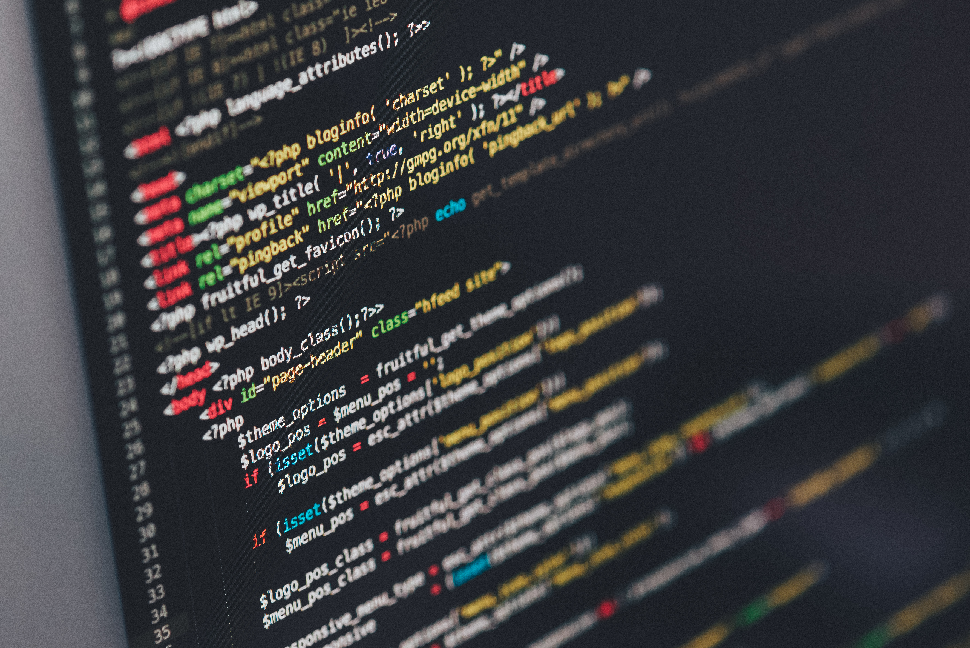
Part 2
If-statements
Else-statements
If-else-statements
Handling input
unsplash.com

Slide 32
Exercise 2.1: If Statements Part 1/3
#include <iostream>
using namespace std;
int main() {
int myNumber = 40;
if (myNumber > 30) {
cout << myNumber << " is a pretty big number.\n";
}
Notes:
#include <iostream>
using namespace std;
int main() {
//MARK: Part 1
//Let's write a basic logic statment.
int myNumber = 40; //This is a regular integer variable.
//We're going to use this variable in our logic statement.
//This first logic statement is called an if-statement. It goes like this:
if (myNumber > 30) {
//You start by writing "if" and then a "condition" surrounded by parenthesis.
//In our case, the condition is "myNumber > 30". This statement asks
//"is the value in myNumber greater than 30?"
//If myNumber is greater than 30, the condition statement returns "true".
//If not, the condition statement returns "false".
cout << myNumber << " is a pretty big number.\n";
}
//Run this, and see what happens.
//If the condition is "true", the code inside the curly brackets of the "if-statement" is run.
//If the condition is "false", the program skips over that code.
//Change the number, and run it again. What happens when the number is
//something lower than 30?
//Nothing happens, right? It doesn't say anything in the console.
//That's because we didn't tell it to do anything if the condition was "false".
//We only specified that it should say something if the condition was true.

Slide 33
Exercise 2.1: If Statements Part 2/3
myNumber = 20;
if (myNumber > 30) {
cout << myNumber << " is a pretty big number.\n";
} else {
cout << myNumber << " is a fairly small number.\n";
}
Notes:
//MARK: Part 2
//Let's see how we can tell the code to do something if the condition is false.
//For this exercise, let's change the value of myNumber to equal 20.
myNumber = 20; //Remember that variables can have their values changed or modified.
//Copy the "if-statement" you just wrote, and paste it below (or just add on as you go).
if (myNumber > 30) {
cout << myNumber << " is a pretty big number.\n"; //cout statement 1
} else { //Here is where we start writing somthing new.
//An "else-statement" is used to run code
//only if the above condition ("myNumber > 30") is false.
cout << myNumber << " is a fairly small number.\n"; //cout statement 2
}
//Run the program and see what happens.
//If myNumber is greater than 30, then the code runs "cout statement 1"
//If myNumber is less than 30, then the code runs "cout statement 2"
//Now what happens if myNumber is equal to 30? Give it a try above and run the code.
//See how nothing happens? Let's see how to run some code if myNumber is equal to 30:

Slide 34
Exercise 2.1: If Statements Part 3/3
if (myNumber > 30) {
cout << myNumber << " is greater than 30.\n";
} else if (myNumber < 30) {
cout << myNumber << " is less than 30.\n";
} else {
cout << myNumber << " is equal to 30.\n";
}
Notes:
//MARK: Part 3
//What follows will be a series of statements. Two we've seen before ("if" and "else"),
//but the middle one ("else if") is new.
if (myNumber > 30) { //If myNumber is greater than 30
//Run the following code
cout << myNumber << " is greater than 30.\n";
} else if (myNumber < 30) { //This checks yet another condition. If the above
//condition ("myNumber > 30") is false, then this else-if statement will check if
//"myNumber < 30", or if myNumber is less than 30.
//If the condition is true, it will run the following code:
cout << myNumber << " is less than 30.\n";
} else { //If myNumber is neither less than or greater than 30, then it must be equal to 30
//Run this code if the two above conditions are false (or if something else went wrong)
cout << myNumber << " is equal to 30.\n";
}
//Now, what happens if we want to check a condition, but only if another condition is true?

Slide 35
Modulus Operators 1/2
cout << "7 % 2 = " << 7 % 2 << " (or 7 divided by 2 has a remander of " << 7 % 2 << ")" << endl; //Ouputs “7 % 2 = 1…”
int number = 50;
if ((number % 2) == 0) {
if (number > 40) {
cout << number << " is the number you need! It's even, and it's greater than 40.\n";
} else if (number < 40) {
cout << number << " is not the number you need. It's even, but it is smaller than 40.\n";
…
Notes:
//MARK: Part 4
//Let's write a new statement. Start a new program if you want, so that it's less confusing.
//Let's make a new variable:
int number = 50;
//Let's introduce another math symbol, called the "modulus operator".
//This action is done using the percent symbol (%) accessed by holding
//shift and pressing the (5) key on your keyboard.
//The modulus operator is used to find the remander of a division process.
//So
cout << "7 % 2 = " << 7 % 2 << " (or 7 divided by 2 has a remander of " << 7 % 2 << ")" << endl;
//Will print out "1". This means that 7 divided by 2 has a remainder of 1.
//This is because 7 cannot be evenly divided by 2. Can you figure out what
//the modulus operator will output for this division problem:
cout << "8 % 2 = " << 8 % 2 << " (or 8 divided by 2 has a remander of " << 8 % 2 << ")" << endl;
//The answer is "0". THat's because 8 can be evenly divided by 2, so the remainder is
//0, or no remainder. What does this mean? Well, it means that one thing we can
//use the modulus operator for is to determine whether a number can be divided by another number.
//If 10 can be divided by 5, then "10 % 5" will output "0".
//Let's say we need a number that is even and greater than 40 (who knows why we would need
//a number like that, but let's just pretend).
//So, let's create a program that first determines if a number is even (or divisible by 2),
//then checks if the number is greater than or less than 40 if the number is divisible by two.
//There's no point in checking if the number greater than or less than 40, if the number is
//no even. You do that sort of thing in programming all the time, to speed things up for
//the users. If something needs to meet two conditions, but it doesn't meet the first one,
//then there's no point in wasting time checking the second condition.
//Let's start with the first if-statement.
//Note: when checkin if something is equal to something else in an "if-statement", you must
//use the "==" operator. This is so that the compiler doesn't think you're trying to set
//number TO BE 0. Your just checking the condition. For instance:
//"number = 0" Will make "number" hold the value 0 and forget what it was holding before.
//"number == 0" Will check if "number" is equal to 0. "number" still holds the same value as before.
if ((number % 2) == 0) {//This is asking, "is the remainder of 'number' divided by 2 equal to 0?"
//Notice that we put "number % 2" inside of parenthesis. This is so that there is no confusion
//about which operation should be done first. Remember the Order of
//Operations? "Please Excuse My Dear Aunt Sally" helps you remember which operations are done first
//by the code (and in math). First you do Parenthesis, then Exponents, the Multiplication,
//then Division, then Adding, then Subtraction last. (And you do every duplicate operation from left
//to right). By putting "number % 2" inside of parenthesis, we make sure the compiler is checking
//to see if "number % 2" is equal to 0, not just if "2" is equal to 0.
//OK, so this code is run if "(number % 2) == 0" is true (because that means that "number" is
//divisible by 2, or that it's an even number).
//Now we need to check if "number" is greater than or less than 40. How do we do that?
//With a "nested if-statement". You can put an if-statement within another if-statement.
if (number > 40) { //If the number is greater than 40
//Run the following code:
cout << number << " is the number you need! It's even, and it's greater than 40.\n";
} else if (number < 40) {
//Run the following code:
cout << number << " is not the number you need. It's even, but it is smaller than 40.\n";
} else {
//Run the following code:
cout << number << " is not the number you need. It's even, but it is equal to 40.\n";
}
} else { //This else statement is paired with the first if statement up above. ("if ((number % 2) == 0)")
//If the condition "(number % 2) == 0" is false, run the following code:
cout << number << " is not the number you need. It's not even.\n";
}
//So there you have it! if, else, and if-else statements are fundamentally important to any programming
//language. And you just built four different programs using them! How's that for awesome!?
return 0;
}

Slide 36
Modulus Operators 2/2
} else {
cout << number << " is not the number you need. It's even, but it is equal to 40.\n";
}
} else {
cout << number << " is not the number you need. It's not even.\n";
}
return 0;
}
Notes:
//MARK: Part 4
//Let's write a new statement. Start a new program if you want, so that it's less confusing.
//Let's make a new variable:
int number = 50;
//Let's introduce another math symbol, called the "modulus operator".
//This action is done using the percent symbol (%) accessed by holding
//shift and pressing the (5) key on your keyboard.
//The modulus operator is used to find the remander of a division process.
//So
cout << "7 % 2 = " << 7 % 2 << " (or 7 divided by 2 has a remander of " << 7 % 2 << ")" << endl;
//Will print out "1". This means that 7 divided by 2 has a remainder of 1.
//This is because 7 cannot be evenly divided by 2. Can you figure out what
//the modulus operator will output for this division problem:
cout << "8 % 2 = " << 8 % 2 << " (or 8 divided by 2 has a remander of " << 8 % 2 << ")" << endl;
//The answer is "0". THat's because 8 can be evenly divided by 2, so the remainder is
//0, or no remainder. What does this mean? Well, it means that one thing we can
//use the modulus operator for is to determine whether a number can be divided by another number.
//If 10 can be divided by 5, then "10 % 5" will output "0".
//Let's say we need a number that is even and greater than 40 (who knows why we would need
//a number like that, but let's just pretend).
//So, let's create a program that first determines if a number is even (or divisible by 2),
//then checks if the number is greater than or less than 40 if the number is divisible by two.
//There's no point in checking if the number greater than or less than 40, if the number is
//no even. You do that sort of thing in programming all the time, to speed things up for
//the users. If something needs to meet two conditions, but it doesn't meet the first one,
//then there's no point in wasting time checking the second condition.
//Let's start with the first if-statement.
//Note: when checkin if something is equal to something else in an "if-statement", you must
//use the "==" operator. This is so that the compiler doesn't think you're trying to set
//number TO BE 0. Your just checking the condition. For instance:
//"number = 0" Will make "number" hold the value 0 and forget what it was holding before.
//"number == 0" Will check if "number" is equal to 0. "number" still holds the same value as before.
if ((number % 2) == 0) {//This is asking, "is the remainder of 'number' divided by 2 equal to 0?"
//Notice that we put "number % 2" inside of parenthesis. This is so that there is no confusion
//about which operation should be done first. Remember the Order of
//Operations? "Please Excuse My Dear Aunt Sally" helps you remember which operations are done first
//by the code (and in math). First you do Parenthesis, then Exponents, the Multiplication,
//then Division, then Adding, then Subtraction last. (And you do every duplicate operation from left
//to right). By putting "number % 2" inside of parenthesis, we make sure the compiler is checking
//to see if "number % 2" is equal to 0, not just if "2" is equal to 0.
//OK, so this code is run if "(number % 2) == 0" is true (because that means that "number" is
//divisible by 2, or that it's an even number).
//Now we need to check if "number" is greater than or less than 40. How do we do that?
//With a "nested if-statement". You can put an if-statement within another if-statement.
if (number > 40) { //If the number is greater than 40
//Run the following code:
cout << number << " is the number you need! It's even, and it's greater than 40.\n";
} else if (number < 40) {
//Run the following code:
cout << number << " is not the number you need. It's even, but it is smaller than 40.\n";
} else {
//Run the following code:
cout << number << " is not the number you need. It's even, but it is equal to 40.\n";
}
} else { //This else statement is paired with the first if statement up above. ("if ((number % 2) == 0)")
//If the condition "(number % 2) == 0" is false, run the following code:
cout << number << " is not the number you need. It's not even.\n";
}
//So there you have it! if, else, and if-else statements are fundamentally important to any programming
//language. And you just built four different programs using them! How's that for awesome!?
return 0;
}

Slide 37
Exercise 2.2: Handle user input 1/2
#include <iostream>
using namespace std;
int main() {
string input = "";
cout << "Do you have an idea of what program you want to write for your final project?\n";
cout << "Enter \"yes\", \"no\", or \"maybe\":\n";
cin >> input;
if (input == "yes") {
cout << "Good! Start thinking about how you can use what you've been learning today to make that program!\n";
Notes:
#include <iostream>
using namespace std;
int main() {
//Let's make a program that allows a user to say "yes", "no", or "maybe" to a question.
string input = ""; //A variable to hold the user's answer
cout << "Do you have an idea of what program you want to write for your final project?\n";
cout << "Enter \"yes\", \"no\", or \"maybe\":\n"; //Notice that you can ask the cout statement to print a quotation mark by typing (\").
cin >> input; //Prepare for user input
if (input == "yes") { //The user entered "yes"
cout << "Good! Start thinking about how you can use what you've been learning today to make that program!\n";
...

Slide 38
Exercise 2.2: Handle user input 1/2
} else if (input == "no") {
cout << "That's fine! Keep thinking about it! Maybe talk to your classmates about some ideas!\n";
} else if (input == "maybe") {
cout << "Wonderful! Now you can start brainstorming. Try talking to your classmates about your ideas!\n";
} else {
cout << "That answer wasn't an option. Please try again.\n";
}
return 0;
}
Notes:
...
} else if (input == "no") { //The user entered "no"
cout << "That's fine! Keep thinking about it! Maybe talk to your classmates about some ideas!\n";
} else if (input == "maybe") { //The user entered "maybe"
cout << "Wonderful! Now you can start brainstorming. Try talking to your classmates about your ideas!\n";
} else { //Now we need to tell the program what to do if the user entered something other than "yes", "no", or "maybe". What if they entered "YES"? Strings are case sensitive, so "YES" would take the program down here, not to the "yes" section of the if-statement.
cout << "That answer wasn't an option. Please try again.\n";
}
//That's the end! In the next exercise, you'll try to make a calculator program that works similarly to this one.
return 0;
}

Slide 39
Final Exercise: Your Own Project!
Write your very own program!
Notes:
Now you get to create your own project. Hopefully you’ve been brainstorming about it throughout the class.
If you don’t have an idea, I have a list of potential ideas for you if you would like to look at that.
Have fun, talk with your classmates, and explore!
While you’re doing that, I’m going to walk through my final project for anyone who wants to see it. It’s a calculator!

Slide 40
My final project: Calculator
Can you use your knowledge of ”if-statements” to make your own arithmetic calculator? The program should work like this:
User enters two numbers
User enters an operation symbol (“+”, “-”, “*”, “/”)
You perform the appropriate operation
You output the answer to the user
Remember, if you want a decimal answer, you need
decimal-type variables.
Notes:
#include <iostream>
using namespace std;
int main() {
//Here's an example of how this program might work:
//The user should be able to decide whether they want to add, subtract, multiply, or divide the two numbers they input.
//First, let's get the two numbers the user wants to work with:
double num1 = 0;
double num2 = 0;
char operation = '+'; //This will hold the user's input. We only need one character (+, -, *, or /), so we'll make it a "char" (which stands for character, remember?)
cout << "Enter the first number:\n";
cin >> num1;
cout << "Enter the second number:\n";
cin >> num2;
//Now we need the user to decide what to do with the numbers:
cout << "Enter the operation you would like to do (+, -, *, or /):\n";
cin >> operation;
//Now we decide what to do with the user's input:
if (operation == '+') {
cout << num1 << " + " << num2 << " = " << num1 + num2 << ".\n";
} else if (operation == '-') {
cout << num1 << " - " << num2 << " = " << num1 - num2 << ".\n";
} else if (operation == '*') {
cout << num1 << " * " << num2 << " = " << num1 * num2 << ".\n";
} else if (operation == '/') {
cout << num1 << " / " << num2 << " = " << num1 / num2 << ".\n";
} else {
cout << "Invalid input. Please try again.";
}
return 0;
}

Slide 41
My final project: Calculator
#include <iostream>
using namespace std;
int main() {double num1 = 0;
double num2 = 0;
char operation = '+';
cout << "Enter the first number:\n";
cin >> num1;
cout << "Enter the second number:\n";
cin >> num2;
cout << "Enter the operation you would like to do (+, -, *, or /):\n";
cin >> operation;
Notes:
#include <iostream>
using namespace std;
int main() {
//Here's an example of how this program might work:
//The user should be able to decide whether they want to add, subtract, multiply, or divide the two numbers they input.
//First, let's get the two numbers the user wants to work with:
double num1 = 0;
double num2 = 0;
char operation = '+'; //This will hold the user's input. We only need one character (+, -, *, or /), so we'll make it a "char" (which stands for character, remember?)
cout << "Enter the first number:\n";
cin >> num1;
cout << "Enter the second number:\n";
cin >> num2;
//Now we need the user to decide what to do with the numbers:
cout << "Enter the operation you would like to do (+, -, *, or /):\n";
cin >> operation;
//Now we decide what to do with the user's input:
if (operation == '+') {
cout << num1 << " + " << num2 << " = " << num1 + num2 << ".\n";
} else if (operation == '-') {
cout << num1 << " - " << num2 << " = " << num1 - num2 << ".\n";
} else if (operation == '*') {
cout << num1 << " * " << num2 << " = " << num1 * num2 << ".\n";
} else if (operation == '/') {
cout << num1 << " / " << num2 << " = " << num1 / num2 << ".\n";
} else {
cout << "Invalid input. Please try again.";
}
return 0;
}

Slide 42
My final project: Calculator
if (operation == '+') {
cout << num1 << " + " << num2 << " = " << num1 + num2 << ".\n";
} else if (operation == '-') {
cout << num1 << " - " << num2 << " = " << num1 - num2 << ".\n";
} else if (operation == '*') {
cout << num1 << " * " << num2 << " = " << num1 * num2 << ".\n";
} else if (operation == '/') {
cout << num1 << " / " << num2 << " = " << num1 / num2 << ".\n";
} else {
cout << "Invalid input. Please try again.";
}
return 0;
}
Notes:
#include <iostream>
using namespace std;
int main() {
//Here's an example of how this program might work:
//The user should be able to decide whether they want to add, subtract, multiply, or divide the two numbers they input.
//First, let's get the two numbers the user wants to work with:
double num1 = 0;
double num2 = 0;
char operation = '+'; //This will hold the user's input. We only need one character (+, -, *, or /), so we'll make it a "char" (which stands for character, remember?)
cout << "Enter the first number:\n";
cin >> num1;
cout << "Enter the second number:\n";
cin >> num2;
//Now we need the user to decide what to do with the numbers:
cout << "Enter the operation you would like to do (+, -, *, or /):\n";
cin >> operation;
//Now we decide what to do with the user's input:
if (operation == '+') {
cout << num1 << " + " << num2 << " = " << num1 + num2 << ".\n";
} else if (operation == '-') {
cout << num1 << " - " << num2 << " = " << num1 - num2 << ".\n";
} else if (operation == '*') {
cout << num1 << " * " << num2 << " = " << num1 * num2 << ".\n";
} else if (operation == '/') {
cout << num1 << " / " << num2 << " = " << num1 / num2 << ".\n";
} else {
cout << "Invalid input. Please try again.";
}
return 0;
}

Slide 43
Computer Programming With C++!
Thank you!! Please complete the online survey!
Notes:
Don’t forget that there are resources for you to continue learning on your own in the Helpful Links file located on the download that I gave you.

